Slide 1

The Battle of Neighborhoods
Exploring Neighborhoods of Toronto
Presented By – Sangita Mitra

Slide 2
Introduction
This capstone project explores neighborhoods in Toronto, including Central Toronto, East Toronto, West Toronto, and Downtown Toronto.
The aim is to help people to explore better facilities around the neighborhoods of Toronto.
The findings will help immigrants make informed decisions and address any concerns they have, including the different kinds of cuisines, pubs, parks, provision stores, and what the city has to offer.
It will help people make smart and efficient decisions on selecting great neighborhoods out of numbers of other Toronto neighborhoods.
In this project, I’ve also explored Thai restaurants in Toronto and tried to find a suitable location to open a new Thai restaurant in the neighborhoods.

Slide 3
Business Problem
This project explores Toronto’s neighborhoods and finds the most suitable location for an entrepreneur to open a Thai restaurant in Toronto.
The business problems that this project trying to solve are –
1. What are the most common venues for different neighborhoods of Toronto?
2. If an entrepreneur wants to open a new Thai restaurant, which place would be most suitable?

Slide 4
Data Description
Data Link: https://en.wikipedia.org/wiki/List_of_postal_codes_of_Canada:_M
Extract data about –
Postal Code
Borough
Neighborhoods
Latitude
Longitude
Venues
Thai Restaurant

Slide 5
Methodology
Extracting the list of Toronto neighborhoods by web scrapping using Pandas packages from Wikipedia page.
Extracting coordinates with latitude and longitude of each neighborhood of Toronto using IBM’s csv file.
Created a new data frame with Borough that contains Toronto.
Visualized the map of Toronto using the Folium package.
Using Foursquare API, collected information about each neighborhood, including the neighborhood, geo-coordinates, venue, and venue categories.
Find the top 10 most common venue categories in Toronto’s neighborhood.
Using K-means clustering, the neighborhoods of Toronto is clustered into 3 clusters, and the map of clustered neighborhoods is visualized using Folium.

Slide 6
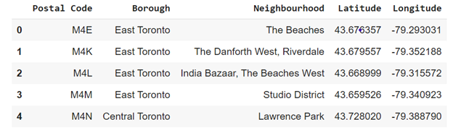
Data of Toronto Neighborhoods

Slide 7
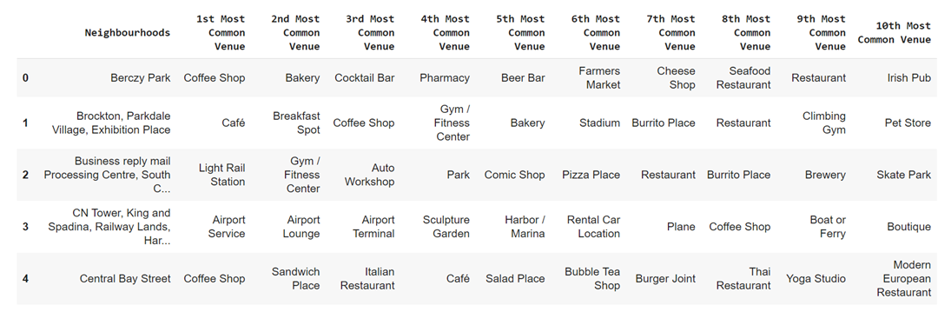
Most Common Venues of Each Neighborhoods

Slide 8
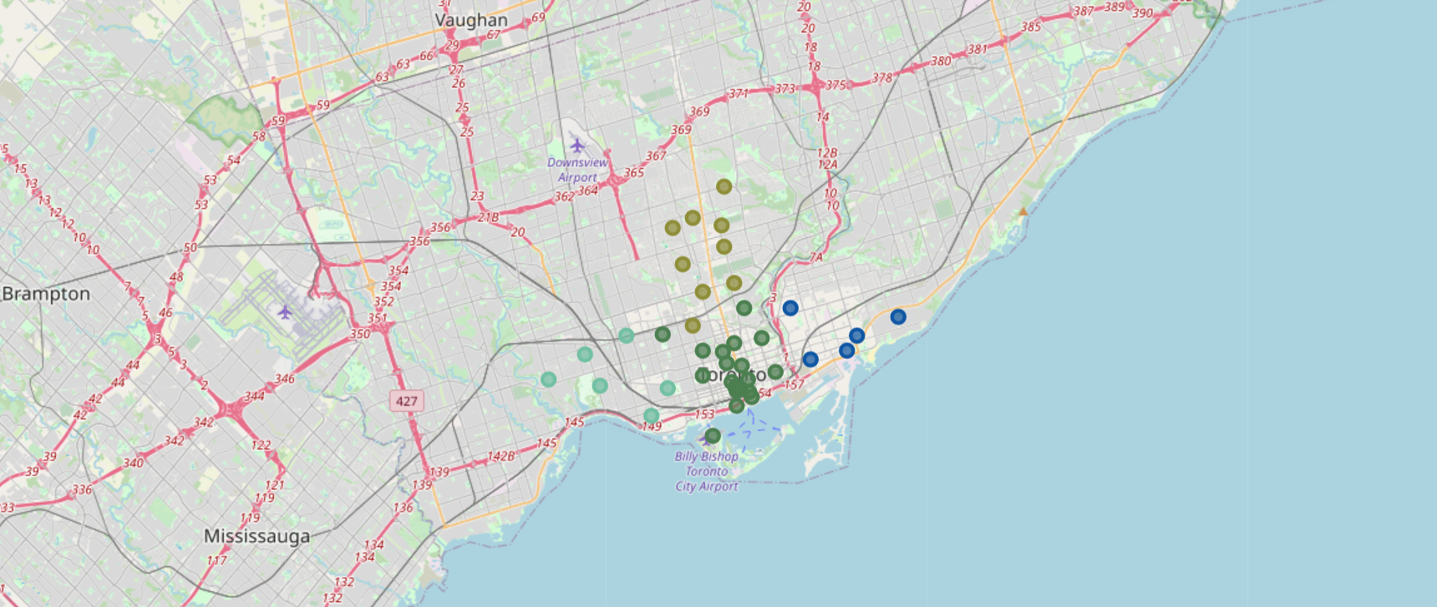
Map of Neighborhoods of Toronto

Slide 9
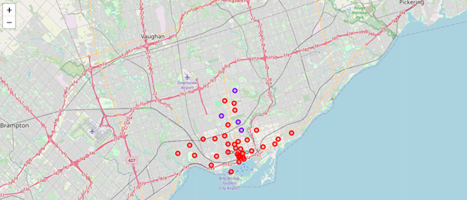
Clustering of Neighborhoods of Toronto

Slide 10
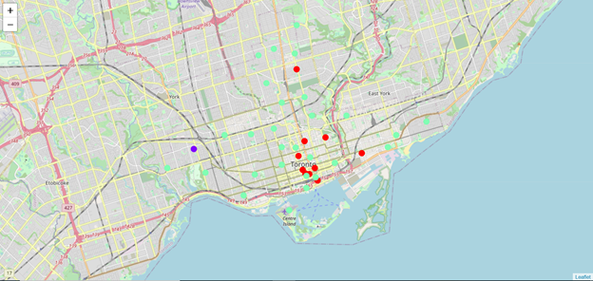
Clustering of Thai Restaurants

Slide 11
Result
Clustered the neighborhoods in Toronto into 3 clusters based on their frequency of occurrence for Thai restaurants using K-means clustering and visualized the map using Folium.
Cluster 0: Neighborhoods with a low number of Thai restaurants
Cluster 1: Neighborhoods with no Thai restaurants
Cluster 2: Neighborhoods with a high number of Thai restaurants
The results are visualized in the above map with Cluster 0 in red color, Cluster 1 in purple color, and Cluster 2 in light green color.

Slide 12
Discussions
The neighborhoods of Toronto are very multicultural.
Most Thai restaurants are in Cluster 2 (Green), which is around Regent Park, India Bazar, Queen’s park, Toronto Island areas
Lowest (close to zero) no of Thai restaurants in Cluster 1 (Purple), which are near High Park areas.
Fewer Thai restaurants in Cluster 0 (Red) around First Canadian Place, Richmond, and Victoria Hotel
Therefore, there are good opportunities to open near High Park, Toronto, as the competition below.
This project recommends the entrepreneur open an authentic Thai restaurant in these locations with little to no competition.

Slide 13
Conclusions
This project aimed to explore Toronto’s city and find the most common venues in each neighborhood for potential tourists and migrants.
The city of Toronto offers a multicultural, diverse, and certainly entertaining experience.
Applied k-means clustering approach to find suitable location to open a Thai restaurant.
This project recommends the entrepreneur to open an authentic Thai restaurant near High Park as the competition will be low in that area.

